Slide 1
Heading
Destination
Wind_App
Wind_True

Slide 2
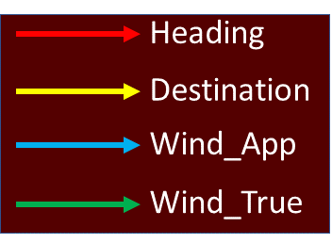

Slide 3
5
6
7
8
9
4
10
3
11
R45
Ground Speed
G45
1
Upwind Speed
0
7 6 5 4 3 3 1 0
0 1 2 3 4 5 6 7
R90
G90
R135
G135

